Slide 1
Title of Topic: OPERATORS IN SQL Course Code: 23IT201 Course Title: DataBase Management Systems MODULE –II Academic Year: 2024 - 2025 (Even Sem)
23IT201- DATABASE MANAGEMENT SYSTEMS
MODULE II CONSTRAINTS AND SQL COMMANDS

Slide 2
Addition Operator
23IT201- DATABASE MANAGEMENT SYSTEMS
returns new column named total_amount which is 100 added to the amount field
SELECT item, amount, amount+100 AS total_amount FROM Orders;
MODULE 2 -CONSTRAINTS AND SQL COMMANDS

Slide 3
SUBTRACTION
23IT201- DATABASE MANAGEMENT SYSTEMS
-- returns new column named offer_price which is
-- 20 subtracted to the amount field
SELECT item, amount, amount-20 AS offer_price
FROM Orders;
MODULE 2 -CONSTRAINTS AND SQL COMMANDS
MODULE 2 -CONSTRAINTS AND SQL COMMANDS

Slide 4
MULTIPLICATION
23IT201- DATABASE MANAGEMENT SYSTEMS
-- returns new column named total_amount which is
-- 4 multiplied to the amount field
SELECT item, amount, amount*4 AS total_amount
FROM Orders;

Slide 5
DIVISION
23IT201- DATABASE MANAGEMENT SYSTEMS
-- returns new column named half_amount which is
-- divided by 2 to the amount field
SELECT item, amount, amount/2 AS half_amount
FROM Orders;

Slide 6
MODULO
23IT201- DATABASE MANAGEMENT SYSTEMS
-- returns 1 which is remainder
SELECT 10 % 3 AS result;

Slide 7
EQUAL TO
23IT201- DATABASE MANAGEMENT SYSTEMS
-- returns records where customer_id is only 4
SELECT order_id, item, amount
FROM Orders
WHERE customer_id = 4;

Slide 8
LESS THAN
23IT201- DATABASE MANAGEMENT SYSTEMS
-- returns records where amount is less than 400 (exclusive)
SELECT order_id, item, amount
FROM Orders
WHERE amount < 400;

Slide 9
GREATER THAN
23IT201- DATABASE MANAGEMENT SYSTEMS
-- returns records where amount is greater than 400 (exclusive)
SELECT order_id, item, amount
FROM Orders
WHERE amount > 400;

Slide 10
LESS THAN EQUAL TO
23IT201- DATABASE MANAGEMENT SYSTEMS
-- returns records where amount is less than or equal to 400
SELECT order_id, item, amount
FROM Orders
WHERE amount <= 400;

Slide 11
GREATER THAN EQUAL TO
23IT201- DATABASE MANAGEMENT SYSTEMS
-- returns records where amount is greater than or equal to 400
SELECT order_id, item, amount
FROM Orders
WHERE amount >= 400;

Slide 12
NOT EQUAL
23IT201- DATABASE MANAGEMENT SYSTEMS
23IT201- DATABASE MANAGEMENT SYSTEMS
-- returns records where amount is not equal to 400
SELECT order_id, item, amount
FROM Orders
WHERE amount != 400;
SELECT order_id, item, amount
FROM Orders
WHERE amount <> 400;

Slide 13
ANY
23IT201- DATABASE MANAGEMENT SYSTEMS
SELECT *
FROM Teachers
WHERE age = ANY (
SELECT age
FROM Students
);

Slide 14
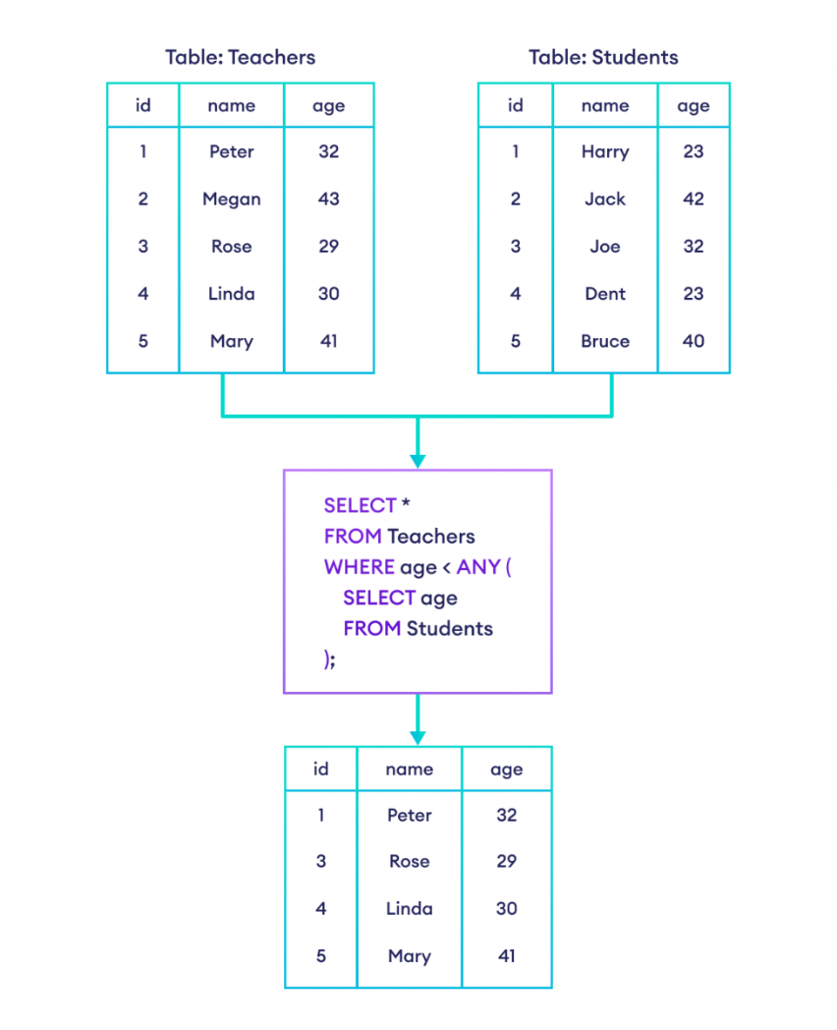

Slide 15
ALL
23IT201- DATABASE MANAGEMENT SYSTEMS
SELECT *
FROM Teachers
WHERE age > ALL (
SELECT age
FROM Students
);

Slide 16
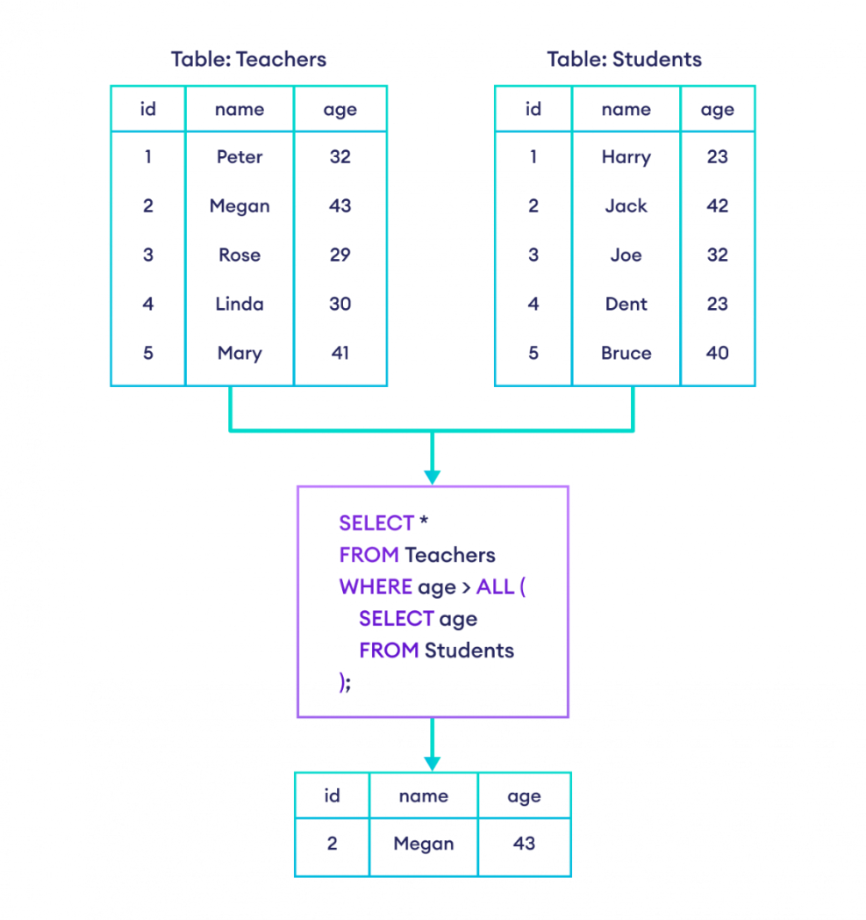

Slide 17
AND
23IT201- DATABASE MANAGEMENT SYSTEMS
-- select the first_name and last_name of all customers
-- who live in 'USA' and have the last name 'Doe'
SELECT first_name, last_name
FROM Customers
WHERE country = 'USA' AND last_name = 'Doe';

Slide 18
OR
23IT201- DATABASE MANAGEMENT SYSTEMS
-- select first and last name of customers
-- who either live in the USA
-- or have the last name 'Doe'
SELECT first_name, last_name
FROM Customers
WHERE country = 'USA' OR last_name = 'Doe';

Slide 19
NOT
23IT201- DATABASE MANAGEMENT SYSTEMS
-- select customers who don't live in the USA
SELECT first_name, last_name
FROM Customers
WHERE NOT country = 'USA';

Slide 20
MULTIPLE OPERATORS
23IT201- DATABASE MANAGEMENT SYSTEMS
-- select customers who live in either USA or UK and whose age is less than 26
SELECT *
FROM Customers
WHERE (country = 'USA' OR country = 'UK') AND age < 26;

Slide 21
MULTIPLE OPERATORS
23IT201- DATABASE MANAGEMENT SYSTEMS
-- exclude customers who are from the USA and have 'Doe' as their last name
SELECT *
FROM customers
WHERE NOT country = 'USA' AND NOT last_name = 'Doe';

Slide 22
BETWEEEN
-- select rows where the amount is between 200 and 600
SELECT item, amount
FROM Orders
WHERE amount BETWEEN 200 AND 600;

Slide 23
IN
23IT201- DATABASE MANAGEMENT SYSTEMS
-- select customers from the USA
SELECT first_name, country
FROM Customers
WHERE country IN ('USA');

Slide 24
NOT IN
23IT201- DATABASE MANAGEMENT SYSTEMS
-- select rows where country is not UK or UAE
SELECT first_name, country
FROM Customers
WHERE country NOT IN ('UK', 'UAE');

Slide 25
EXISTS
23IT201- DATABASE MANAGEMENT SYSTEMS
The EXISTS operator is used to test for the existence of any record in a subquery.
The EXISTS operator returns TRUE if the subquery returns one or more records.

Slide 26
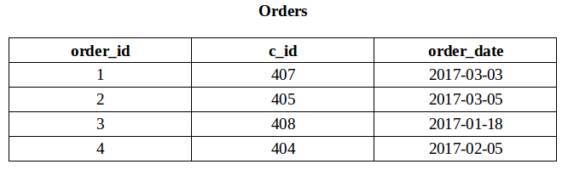
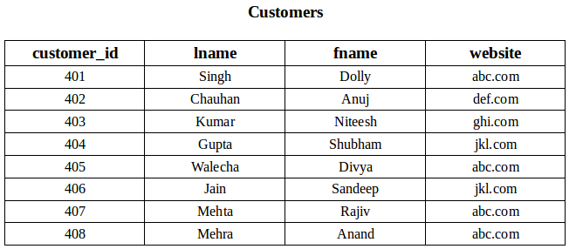
EXISTS
23IT201- DATABASE MANAGEMENT SYSTEMS
To fetch the first and last name
of the customers
who placed atleast one order.

Slide 27
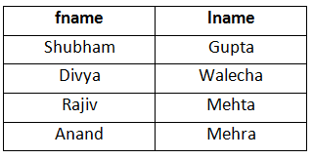
EXISTS
23IT201- DATABASE MANAGEMENT SYSTEMS
SELECT fname, lname
FROM Customers
WHERE EXISTS (SELECT * FROM Orders
WHERE Customers.customer_id = Orders.c_id);

Slide 28
NOT EXISTS
23IT201- DATABASE MANAGEMENT SYSTEMS
Fetch last and first name of the customers who has not placed any order.
SELECT lname, fname
FROM Customers
WHERE NOT EXISTS (SELECT * FROM Orders WHERE Customers.customer_id = Orders.c_id);

Slide 29
Using EXISTS condition with DELETE statement
23IT201- DATABASE MANAGEMENT SYSTEMS
Delete the record of all the customer from Order Table whose last name is ‘Mehra’.
DELETE
FROM Orders
WHERE EXISTS (SELECT *
FROM customers
WHERE Customers.customer_id = Orders.c_id
AND Customers.lname = 'Mehra');

Slide 30
When to Use SQL EXISTS
23IT201- DATABASE MANAGEMENT SYSTEMS
The EXISTS condition is particularly useful in the following scenarios:
Checking Data Existence: You can use EXISTS to check if related data exists in another table before performing an action (e.g., selecting, updating, deleting).
Performance: EXISTS is often more efficient than using IN when dealing with large datasets, as it stops searching once a match is found.
Correlated Subqueries: EXISTS is ideal for correlated subqueries, where the subquery refers to the outer query’s values.

Slide 31
Differences Between EXISTS and IN
23IT201- DATABASE MANAGEMENT SYSTEMS
EXISTS is used for checking the existence of rows, while IN checks if a value matches any value from a list or subquery result.
EXISTS is more efficient when the subquery results in a large number of rows.
IN works well for small datasets or static lists of values.

Slide 32
Using EXISTS condition with UPDATE statement
23IT201- DATABASE MANAGEMENT SYSTEMS
Update the lname as ‘Kumari’ of customer in Customer Table whose customer_id is 401.
UPDATE Customers
SET lname = 'Kumari'
WHERE EXISTS (SELECT *
FROM Customers
WHERE customer_id = 401);

Slide 33
LIKE
23IT201- DATABASE MANAGEMENT SYSTEMS
SELECT *
FROM Customers
WHERE country LIKE 'U_';
selects customers whose country name starts with U and is followed by only one character.

Slide 34
LIKE
23IT201- DATABASE MANAGEMENT SYSTEMS
SELECT *
FROM Customers
WHERE country NOT LIKE 'USA';

Slide 35
LIKE
23IT201- DATABASE MANAGEMENT SYSTEMS
SELECT *
FROM Customers
WHERE last_name LIKE 'R%t' OR last_name LIKE '%e';

Slide 36
IS NULL
23IT201- DATABASE MANAGEMENT SYSTEMS
SELECT *
FROM Employee
WHERE email IS NULL;

Slide 37
SET OPERATORS
23IT201- DATABASE MANAGEMENT SYSTEMS
There are the following 4 set operators in SQL Server:
UNION: Combine two or more result sets into a single set without duplicates.
UNION ALL: Combine two or more result sets into a single set, including all duplicates.
INTERSECT: Takes the data from both result sets, which are in common.
EXCEPT: Takes the data from the first result set but not in the second result set (i.e., no matching to each other)

Slide 38
SET OPERATORS
23IT201- DATABASE MANAGEMENT SYSTEMS
Rules on Set Operations:
The result sets of all queries must have the same number of columns.
In every result set, the data type of each column must be compatible (well-matched) with the data type of its corresponding column in other result sets.
An ORDER BY clause should be part of the last select statement to sort the result. The first select statement must find out the column names or aliases.

Slide 39
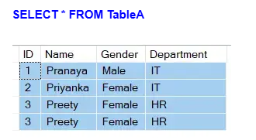
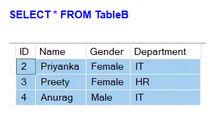
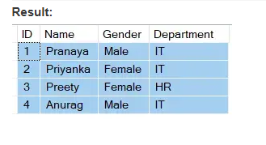
UNION Operator
23IT201- DATABASE MANAGEMENT SYSTEMS
The Union operator will return all the unique rows from both queries. Notice that the duplicates are removed from the result set.
SELECT ID, Name, Gender, Department FROM TableA UNION SELECT ID, Name, Gender, Department FROM TableB

Slide 40
UNION Operator
23IT201- DATABASE MANAGEMENT SYSTEMS
Purpose: The UNION operator combines the result sets of two or more SELECT statements into a single result set.
Distinct Values: It removes duplicate rows between the various SELECT statements.
Use Case: You would use UNION when listing all distinct rows from multiple tables or queries.

Slide 41
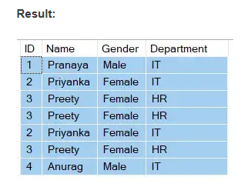
UNION ALL Operator
23IT201- DATABASE MANAGEMENT SYSTEMS
The UNION ALL operator returns all the rows from both queries, including the duplicates.
SELECT ID, Name, Gender, Department FROM TableA UNION ALL SELECT ID, Name, Gender, Department FROM TableB

Slide 42
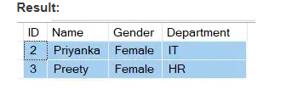
INTERSECT Operator
23IT201- DATABASE MANAGEMENT SYSTEMS
The INTERSECT operator retrieves the common unique rows from the left and right queries. Notice the duplicates are removed.
SELECT ID, Name, Gender, Department FROM TableA INTERSECT SELECT ID, Name, Gender, Department FROM TableB

Slide 43
INTERSECT Operator
23IT201- DATABASE MANAGEMENT SYSTEMS
Purpose: The INTERSECT operator returns all rows common to both SELECT statements.
Distinct Values: Like UNION and EXCEPT, INTERSECT also removes duplicates.
Use Case: You would use INTERSECT when you need to find rows that are shared between two tables or queries.

Slide 44

EXCEPT Operator
23IT201- DATABASE MANAGEMENT SYSTEMS
The EXCEPT operator will return unique rows from the left query that aren’t in the right query’s results.
SELECT ID, Name, Gender, Department FROM TableA EXCEPT SELECT ID, Name, Gender, Department FROM TableB

Slide 45
DISTINCT
23IT201- DATABASE MANAGEMENT SYSTEMS
-- select the unique countries from the customers table
SELECT DISTINCT country
FROM Customers;

Slide 46
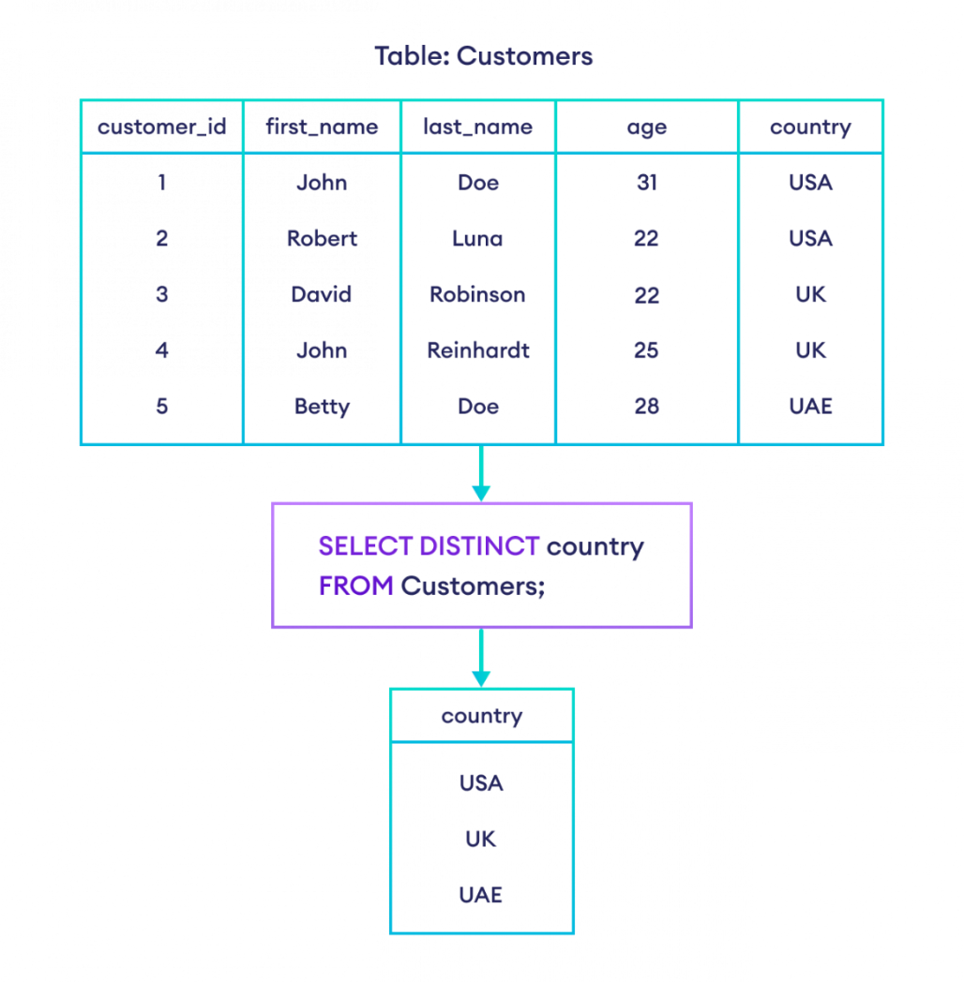

Slide 47
COUNT
23IT201- DATABASE MANAGEMENT SYSTEMS
SELECT COUNT(DISTINCT country)
FROM Customers;

Slide 48
COUNT
23IT201- DATABASE MANAGEMENT SYSTEMS
--returns the number of rows in the Customers table
SELECT COUNT(*)
FROM Customers;

Slide 49
GROUPBY
23IT201- DATABASE MANAGEMENT SYSTEMS
-- select the item column and the count of order ids from the Orders table
-- group them by the item column
SELECT COUNT(order_id), item
FROM Orders
GROUP BY item;

Slide 50
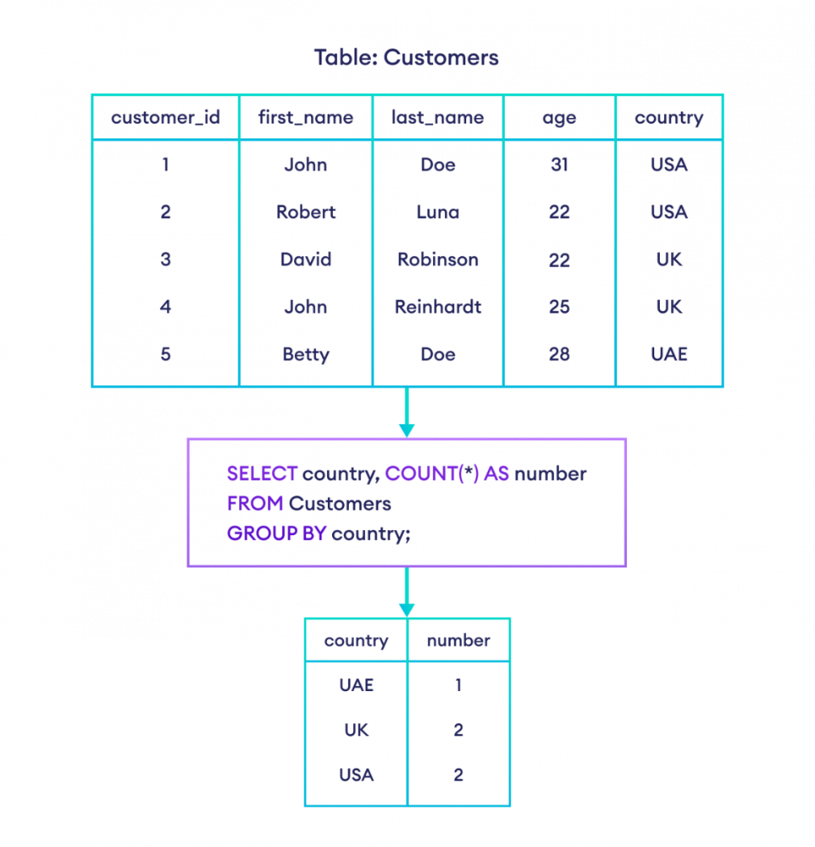

Slide 51
ORDERBY
23IT201- DATABASE MANAGEMENT SYSTEMS
-- orders all rows from Customers in ascending order by country
SELECT *
FROM Customers
ORDER BY country;

Slide 52
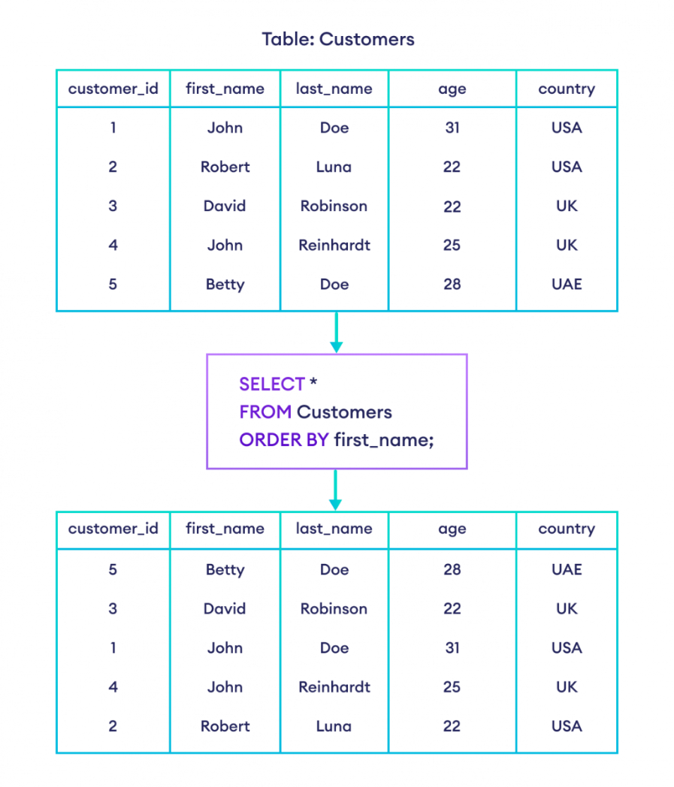

Slide 53
ORDERBY ASC
23IT201- DATABASE MANAGEMENT SYSTEMS
-- orders all rows from Customers in ascending order by age
SELECT *
FROM Customers
ORDER BY age ASC;

Slide 54
ORDERBY DESC
-- order all rows from Customers in descending order by age
SELECT *
FROM Customers
ORDER BY age DESC;

